Slide 1
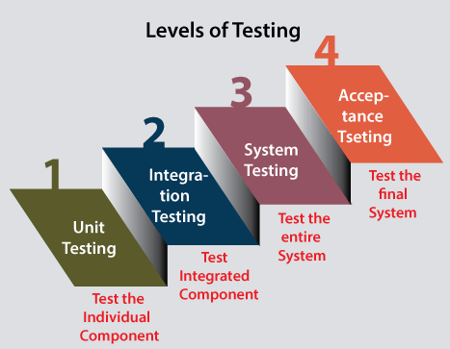
LEVELS OF SOFTWARE TESTING

Slide 2
Unit testing
involves analyzing each unit or an individual component of the software application
Unit testing will help the test engineer and developers in order to understand the base of code that makes them able to change defect causing code quickly

Slide 3
Integration testing
used to test the data flow from one module or component to other modules.
The primary purpose of executing the integration testing is to identify the defects at the interaction between integrated components or units.
When each component or module works separately, we need to check the data flow between the dependent modules, and this process is known as integration testing.

Slide 4
System testing
It is end-to-end testing
we will test the application as a whole system.

Slide 5
Acceptance testing
User acceptance testing (UAT) and is done by the customer before accepting the final product.
It brings confidence and satisfaction to the clients as they are directly involved in the testing process.
This testing helps the project team to know the further requirements from the users directly as it involves the users for testing.

